Slide 1

Whoofer!
©2020
Taleh Aliyev, Ashly Mayle, Ashraf Takla, Nigara Sawirdin

Slide 2
Whoofer!
Whoofer allows users to register for access to the Whoofer page.
Users must register with an email address and password to access the site in order to.
Help admin control access to the site
Update or delete user’s posts
Identify authors of posts

Slide 3
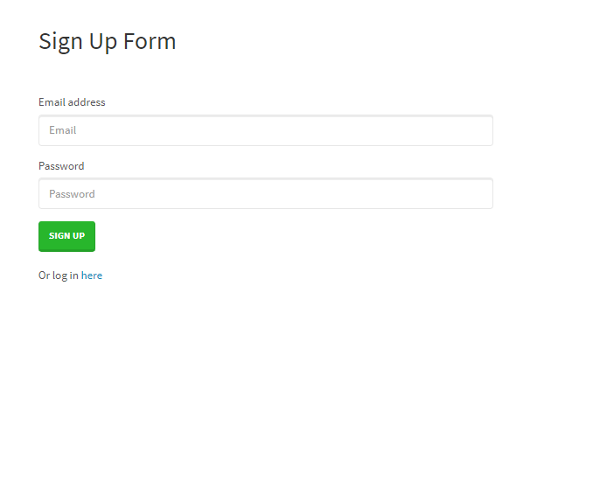
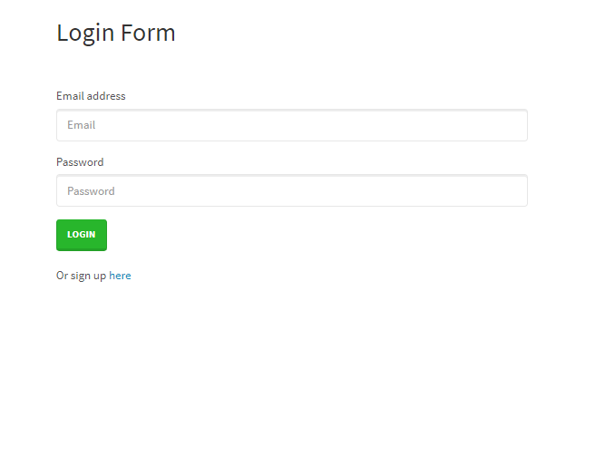
Sign Up/Login

Slide 4
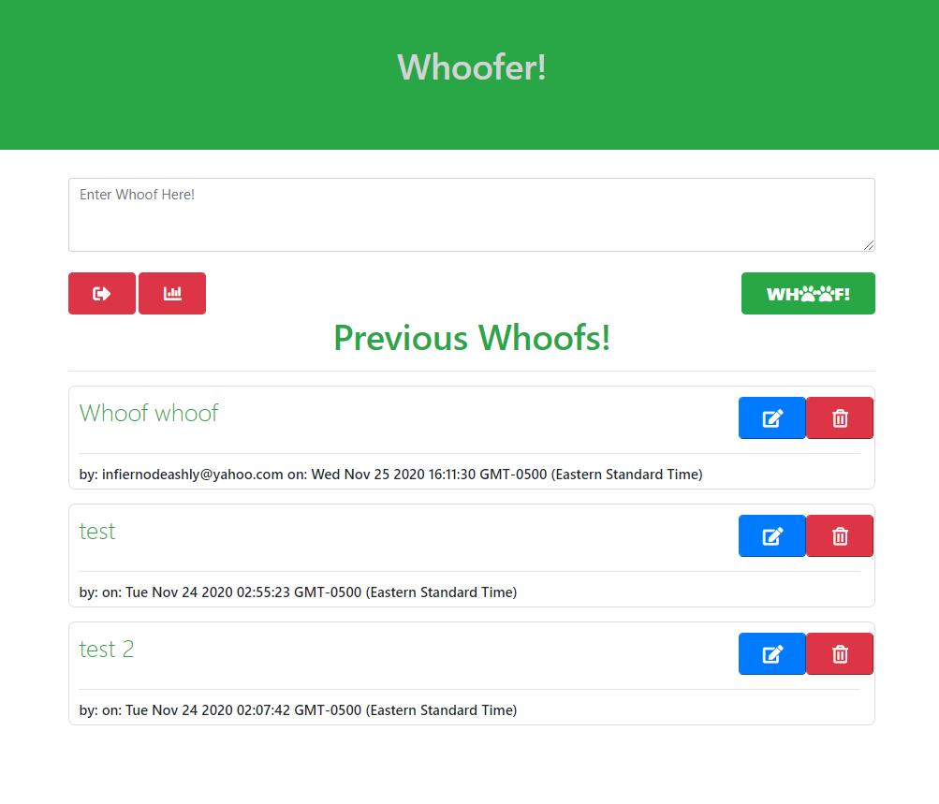
Whoofer Landing Page

Slide 5
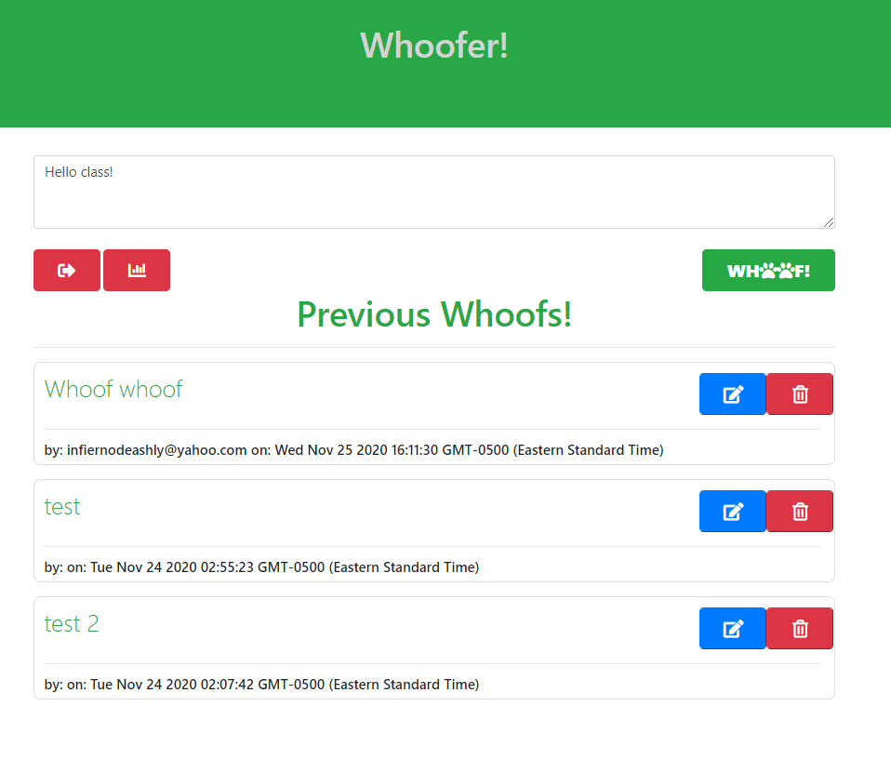
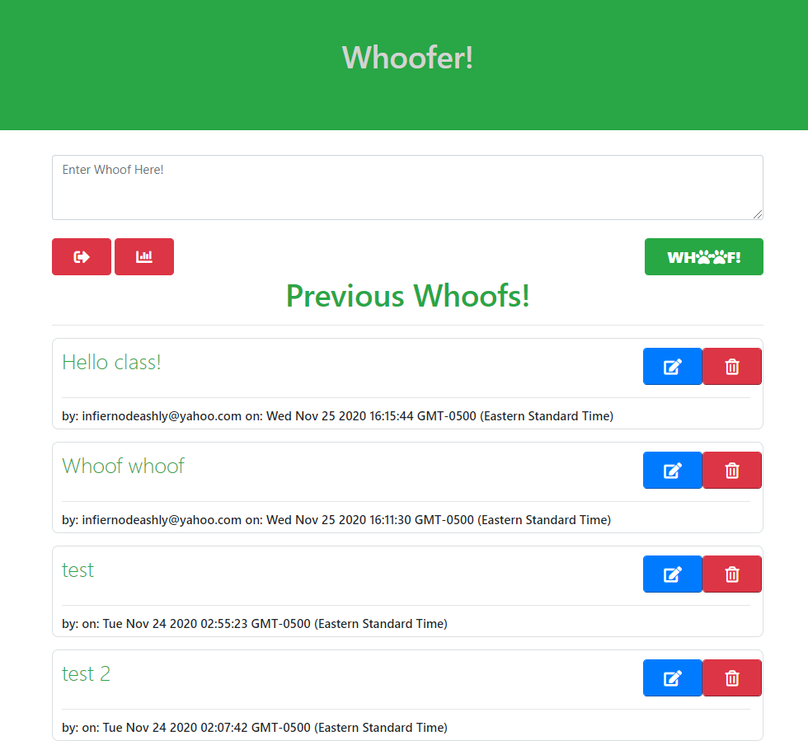
Submitting Whoofs

Slide 6
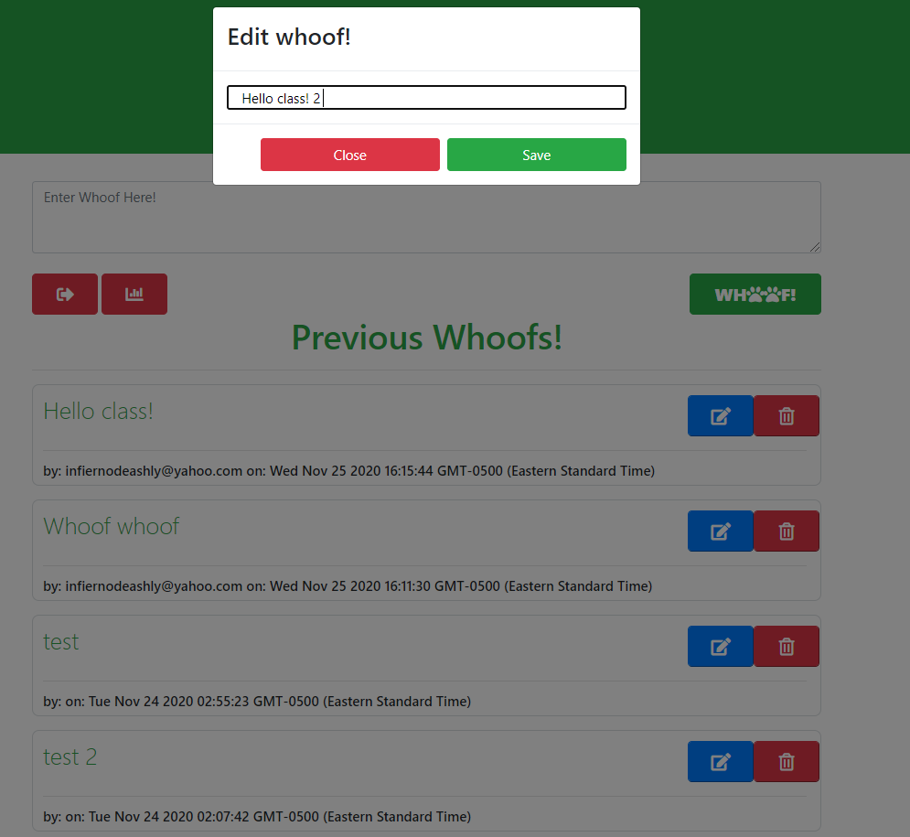
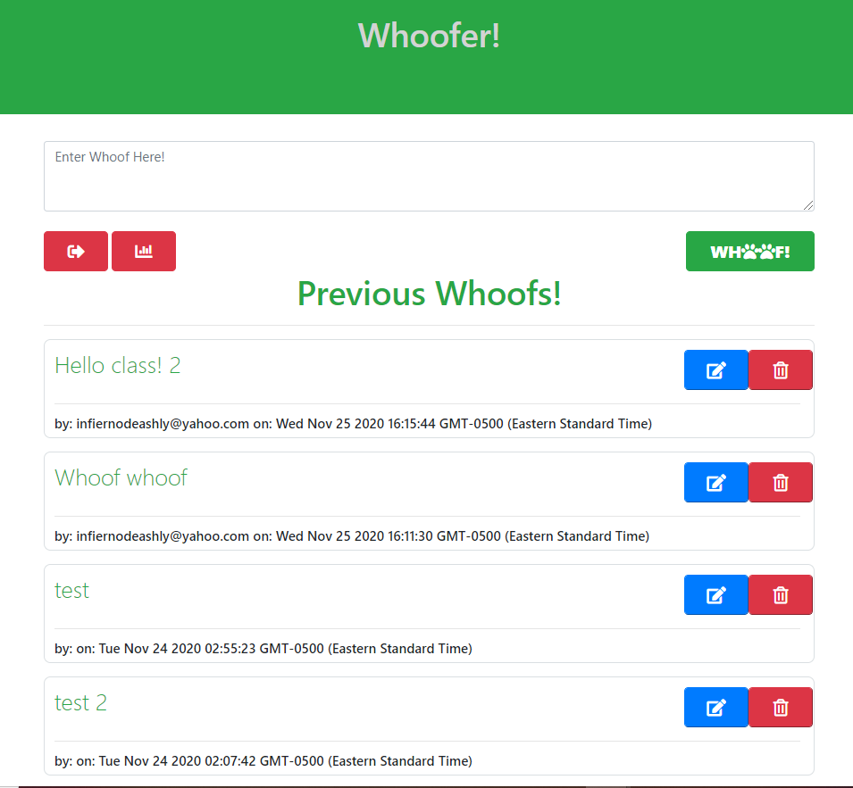
Updating Whoofs

Slide 7
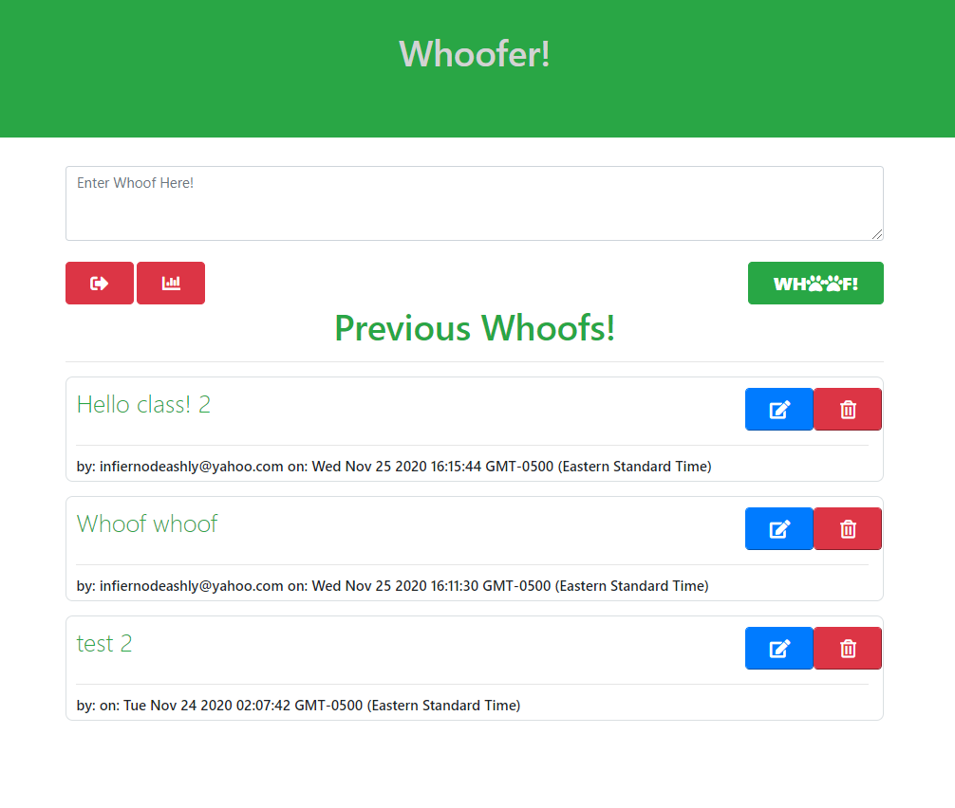
Deleting Whoofs

Slide 8
Future Development
Add search by Author or by Whoof text.
Add ability to Reply to a specific post.
Tie Author to username versus email address.
Add administrator account.
Add charting.js to show Whoof traffic.

Slide 9
Task Breakdown
Back end:
Models and API routes connecting App to sequelize – Taleh Aliyev
Logic connecting page routes –Taleh Aliyev & Ashraf Takla
Back/Front:
Functional Logic – Taleh Aliyev, Ashly Mayle, & Ashraf Takla
Front end:
Handlebars/CSS – Taleh Aliyev, Ashly Mayle, & Ashraf Takla
Host – Ashly Mayle

Slide 10
Links
App: https://glacial-brushlands-67266.herokuapp.com/
Repository: https://github.com/infiernodeashly/whoofer
Notes:
End Links

Slide 11
Resources
Internal build API
Validator.js (future)
Chart.js (future)
Bootstrap
Notes:
End Links

